Slide 1
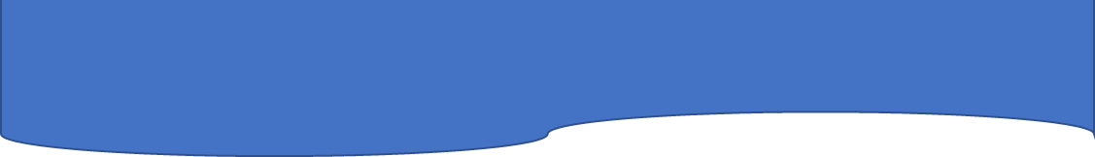
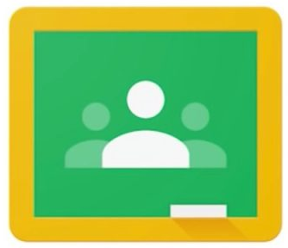

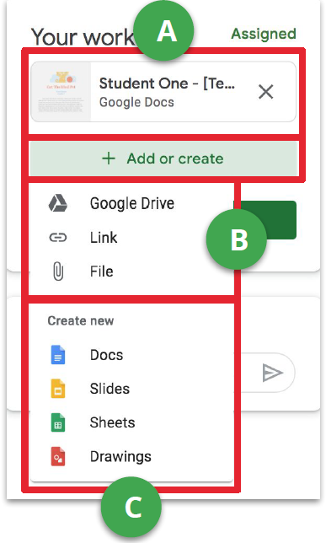
How to submit an assignment in Google Classroom
TO SUBMIT AN ASSIGNMENT
Go to class, then the "Classwork" page, then click on "View Assignment."
There are three different ways you can submit your work:
Method A
To use the file your teacher has given you:
1. Click the attachment under "Your Work" with your name on it.
2. Enter your work
3. Click on the "Turn in" button on the document and confirm, or click the "Turn in" button on the assignment in Google Classroom.
A
B
Method B
To attach an item that has already been created:
1. Under "Your work", click Add or Create and then select Google Drive, Link, or File.
2. Add or create your work files.
3. Select the attachment or enter the URL for a link and click Add.
4. Note: You cannot attach a file that you do not own.
C
Method C
To create and attach a new file:
1. Under "Your work", click Add or create and then select Docs,
Slides, Sheets, or Drawings.
2. A new file attaches to your work and opens.
3. Add or create your work files
4. Click the file and enter your information. Note: You can attach or create more than one file.
5. (Optional) to remove an attachment, next to the attachment name, click Remove.
6. Click Turn In and confirm.
7. The status of the assignment changes to "Turned in".

Slide 2
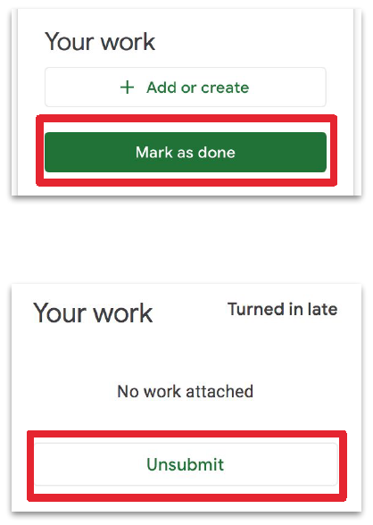
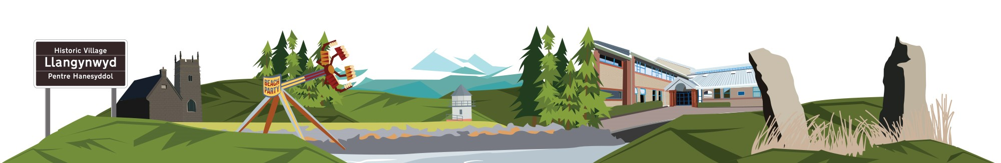
How to submit an assignment in Google Classroom
MARKING AS DONE AND UNSUBMITTING
Marking assignment as “DONE”
Some assignments will have a button that says "Mark as done" instead of turning in.
Important: With any assignment marked as "Turn in" or "Done" after the deadline is entered as late, even if you previously submitted the work before the deadline.
1. Go to the Google Classroom, then the Classwork page, then click the "View Assignment "
2. Complete the assignment.
3. Click Mark as done and confirm.
4. The status of the assignment changes to "Turned in".
UNSUBMITTING AN ASSIGMENT
Once you have turned in an assignment or marking as done, you will see the option to Unsubmit.
Use this if you need to make changes to your work and then resubmit it to your teacher. If you unsubmit an assignment, make sure to resubmit it before the deadline.
1. Go to the Google Classroom, then the Classwork page, then click the "View Assignment. "
2. Click Unsubmit and confirm.
3. Note: This assignment has now not been submitted. Resubmit it before the due date.

